Slide 1
Chapter 4
Functions
Objectives
❏ To design and implement programs with more than one function
❏ To be able to design multi-function programs
❏ To understand the purpose of the function declaration, call, and definition
❏ To understand the four basic function designs
❏ To understand how two functions communicate through parameters
❏ To understand the differences between global and local scope
❏ To understand the software engineering principles of functional cohesion and top–down development

Slide 2
FIGURE 4-1 Derived Types

Slide 3
4-1 Designing Structured Programs
The programs we have presented so far have been very simple. They solved problems that could be understood without too much effort.
The principles of top–down design and structured programming dictate that a program should be divided into a main module and its related modules. Each module should also be divided into submodules according to software engineering principles that we discuss in Section 4.8, “Software Engineering.”

Slide 4
Note
In top–down design, a program is divided into a main module and its related modules. Each module is in turn divided into submodules until the resulting modules are intrinsic; that is, until they are implicitly understood without further division.

Slide 5
FIGURE 4-2 Structure Chart

Slide 6
4-2 Functions in C
In C, the idea of top–down design is done using functions. A C program is made of one or more functions, one and only one of which must be named
main.
In general, the purpose of a function is to receive zero or more pieces of data, operate on them, and return at most one piece of data. At the same time, a function can have a side effect. A function side effect is an action that results in a change in the state of the program.

Slide 7
Note
In C, a program is made of one or more functions, one and only one of which must be called main. The execution of the program always starts with main, but it can call other functions to do some part of the job.

Slide 8
FIGURE 4-3 Structure Chart for a C Program

Slide 9
FIGURE 4-4 Function Concept

Slide 10
Note
A function in C can have a return value, a side effect, or both.
The side effect occurs before the value is returned. The function’s value is the value in the expression of the return statement. A function can be called
for its value, its side effect, or both.

Slide 11
PROGRAM 4-1
Sample Program with Subfunction

Slide 12
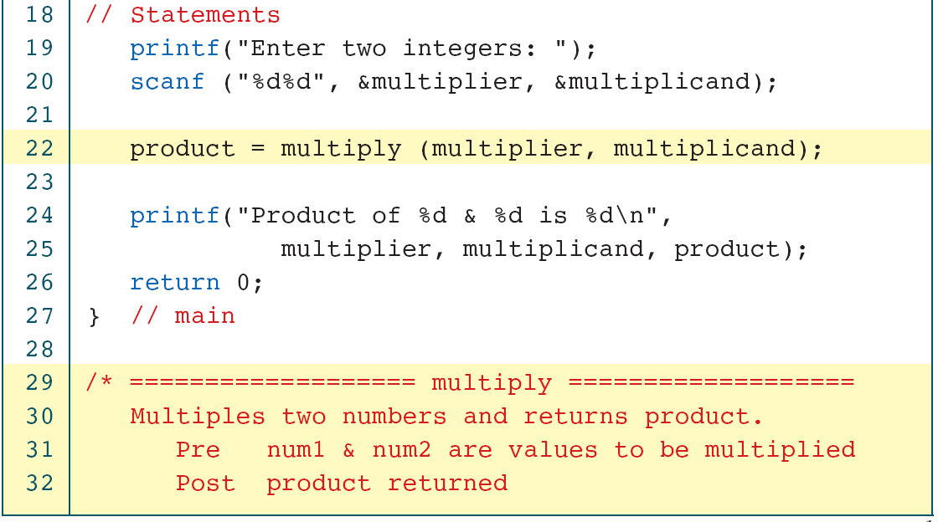
PROGRAM 4-1
Sample Program with Subfunction

Slide 13
PROGRAM 4-1
Sample Program with Subfunction

Slide 14
4-3 User-Defined Functions
Like every other object in C, functions must be both declared and defined. The function declaration gives the whole picture of the function that needs to be defined later. The function definition contains the code for a function.
Topics discussed in this section:
Basic Function Designs
Function Definition
Function Declaration
The Function Call

Slide 15
Note
A function name is used three times: for declaration, in a call, and for definition.

Slide 16
FIGURE 4-5 Declaring, Calling, and Defining Functions

Slide 17
void Functions w/o Parameters
greeting();
result = greeting();

Slide 18
FIGURE 4-6 void Function with Parameters

Slide 19
PROGRAM 4-2
void Function with a Parameter

Slide 20
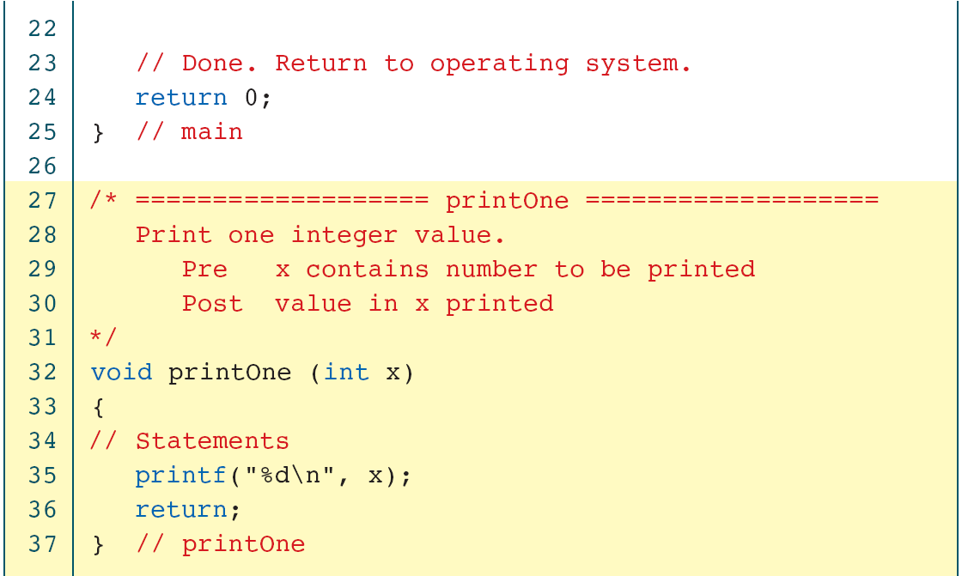
PROGRAM 4-2
void Function with a Parameter

Slide 21
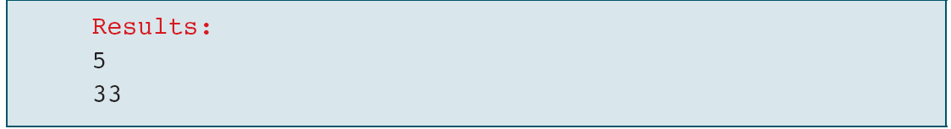
PROGRAM 4-2
void Function with a Parameter

Slide 22
FIGURE 4-7 Non-void Function without Parameters

Slide 23
Non-void Functions w/ Parameters
b = sqr (a);
sqr (a);

Slide 24
FIGURE 4-8 Calling a Function That Returns a Value

Slide 25
PROGRAM 4-3
Read a Number and Square It

Slide 26
PROGRAM 4-3
Read a Number and Square It

Slide 27
PROGRAM 4-3
Read a Number and Square It

Slide 28
PROGRAM 4-3
Read a Number and Square It

Slide 29
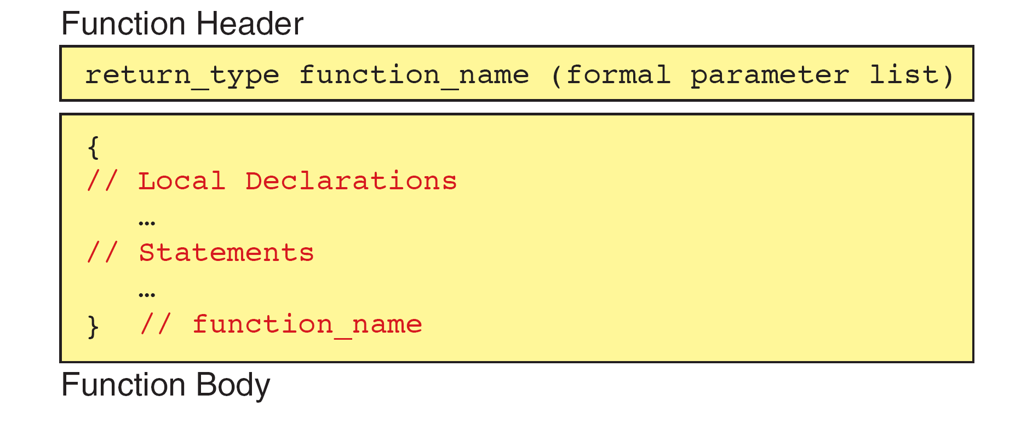
FIGURE 4-9 Function Definition

Slide 30
FIGURE 4-10 Function Return Statements

Slide 31
FIGURE 4-11 Function Local Variables

Slide 32
Note
Formal and Actual Parameters
Formal parameters are variables that are declared in the header of the function definition.
Actual parameters are the expressions in the calling statement.
Formal and actual parameters must match exactly in type, order, and number.
Their names, however, do not need to match.

Slide 33
FIGURE 4-12 Parts of a Function Call

Slide 34
FIGURE 4-13 Examples of Function Calls

Slide 35
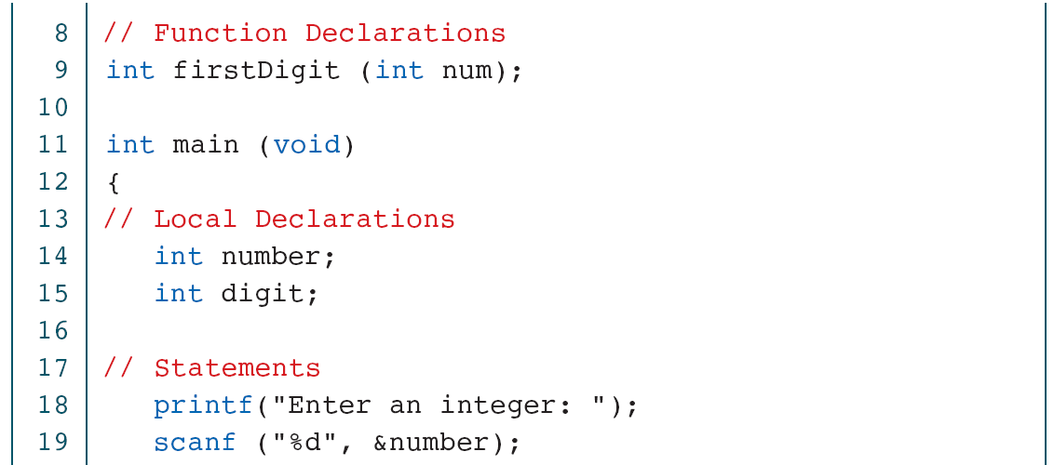
PROGRAM 4-4
Print Least Significant Digit

Slide 36
PROGRAM 4-4
Print Least Significant Digit

Slide 37
PROGRAM 4-4
Print Least Significant Digit

Slide 38
FIGURE 4-14 Design for Add Two Digits

Slide 39
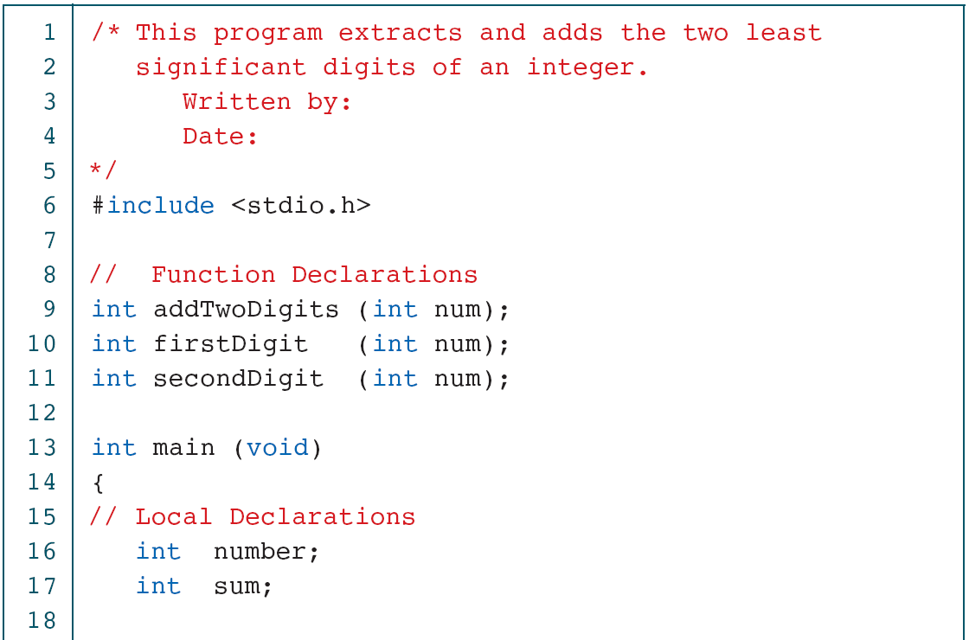
PROGRAM 4-5
Add Two Digits

Slide 40
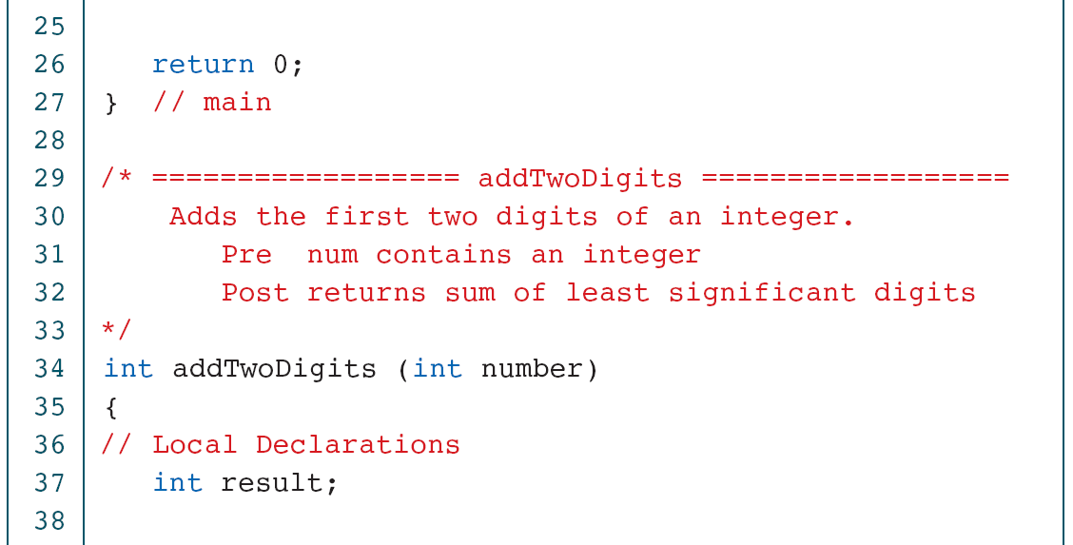
PROGRAM 4-5
Add Two Digits

Slide 41
PROGRAM 4-5
Add Two Digits

Slide 42
PROGRAM 4-5
Add Two Digits

Slide 43
PROGRAM 4-6
Print Six Digits with Comma

Slide 44
PROGRAM 4-6
Print Six Digits with Comma

Slide 45
PROGRAM 4-6
Print Six Digits with Comma

Slide 46
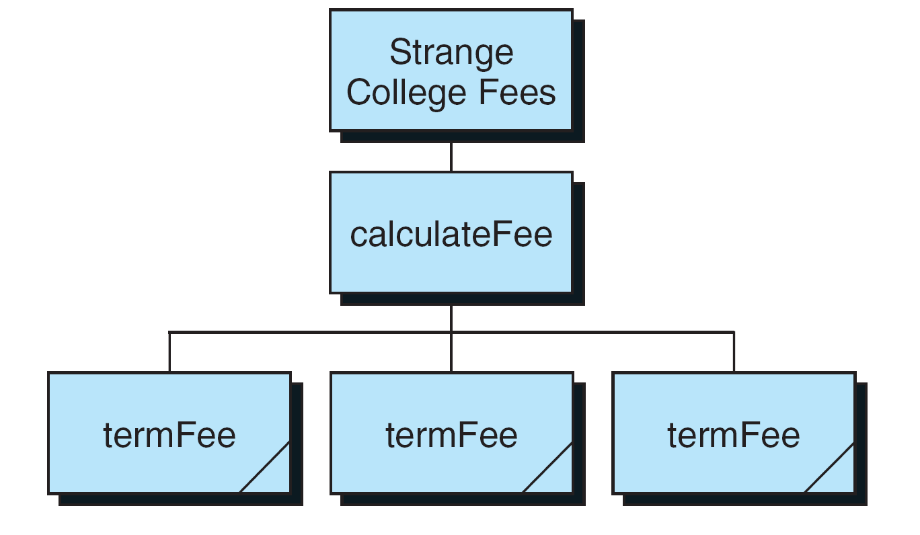
FIGURE 4-15 Design for Strange College fees

Slide 47
PROGRAM 4-7
Strange College Fees

Slide 48
PROGRAM 4-7
Strange College Fees

Slide 49
PROGRAM 4-7
Strange College Fees

Slide 50
PROGRAM 4-7
Strange College Fees

Slide 51
PROGRAM 4-7
Strange College Fees

Slide 52
4-4 Inter-Function Communication
Although the calling and called functions are two separate entities, they need to communicate to exchange data. The data flow between the calling and called functions can be divided into three strategies: a downward flow, an upward flow, and a bi-directional flow.
Topics discussed in this section:
Basic Concept
C Implementation

Slide 53
FIGURE 4-16 Data Flow Strategies

Slide 54
Note
The C language uses only pass by value and return to achieve three types of communications between
a calling and a called function.

Slide 55
FIGURE 4-17 Downward Communication in C

Slide 56
FIGURE 4-18 Downward Communication

Slide 57
FIGURE 4-19 Upward Communication in C

Slide 58
FIGURE 4-20 Upward Communication

Slide 59
Note
To send data from the called function to the calling function:
1. We need to use the & symbol in front of the data variable when we call the function.
2. We need to use the * symbol after the data type when we declare the address variable
3. We need to use the * in front of the variable when we store data indirectly.

Slide 60
FIGURE 4-21 Bi-directional Communication in C

Slide 61
FIGURE 4-22 Bi-directional Communication

Slide 62
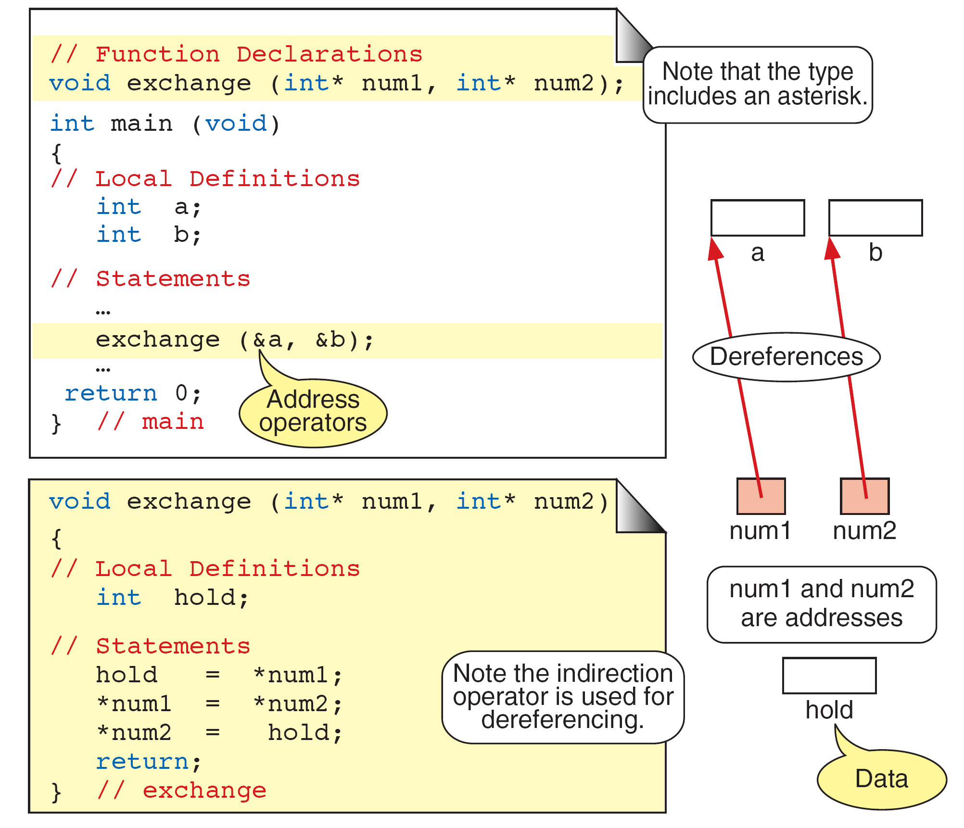
FIGURE 4-23 Exchange Function

Slide 63
FIGURE 4-24 Calculate Quotient and Remainder

Slide 64
FIGURE 4-25 Quotient and Remainder Design

Slide 65
PROGRAM 4-8
Quotient and Remainder

Slide 66
PROGRAM 4-8
Quotient and Remainder

Slide 67
PROGRAM 4-8
Quotient and Remainder

Slide 68
PROGRAM 4-8
Quotient and Remainder

Slide 69
4-5 Standard Functions
C provides a rich collection of standard functions whose definitions have been written and are ready to be used in our programs. To use these functions, we must include their function declarations.
Topics discussed in this section:
Math Functions
Random Numbers

Slide 70
FIGURE 4-26 Library Functions and the Linker

Slide 71
Math Functions
int abs (int number);
long labs (long number);
long long llabs (long long number);
double fabs (double number);
float fabsf (float number);
long double fabsl (long double number);

Slide 72
FIGURE 4-27 Ceiling Function

Slide 73
FIGURE 4-28 Floor Function

Slide 74
Math Functions
Truncate functions: trunc
Round functions: round
Power function: pow
Square root function: sqrt

Slide 75
FIGURE 4-29 Random Number Generation

Slide 76
FIGURE 4-30 Generating a Random Number Series

Slide 77
Random Numbers
srand (997);
srand (time (NULL));
int rand (void);

Slide 78
Note
srand must be called only once for each random number series.

Slide 79
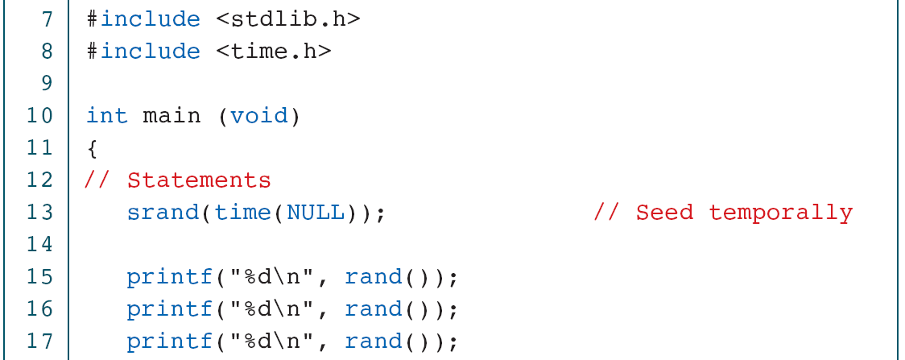
PROGRAM 4-9
Creating Temporal Random Numbers

Slide 80
PROGRAM 4-9
Creating Temporal Random Numbers

Slide 81
PROGRAM 4-10
Creating Pseudorandom Numbers

Slide 82
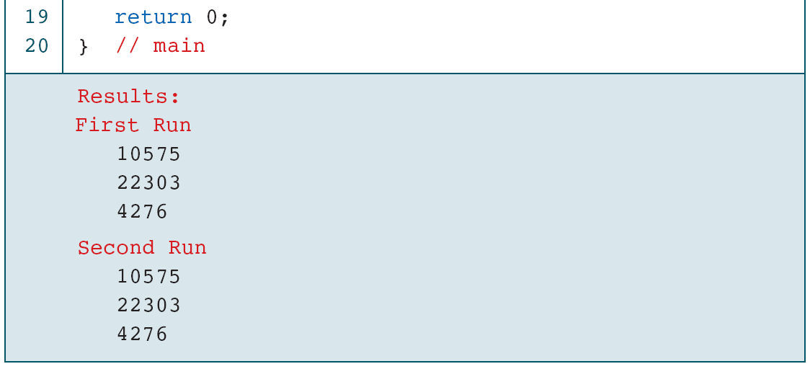
PROGRAM 4-10
Creating Pseudorandom Numbers

Slide 83
FIGURE 4-31 Random Number Scaling for 3–7

Slide 84
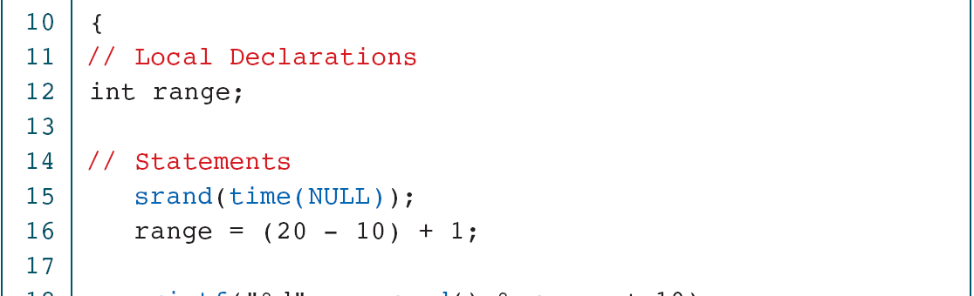
PROGRAM 4-11
Generating Random Numbers in the Range 10 to 20

Slide 85
PROGRAM 4-11
Generating Random Numbers in the Range 10 to 20

Slide 86
PROGRAM 4-12
Generating Random Real Numbers

Slide 87
PROGRAM 4-12
Generating Random Real Numbers

Slide 88
4-6 Scope
Scope determines the region of the program in which a defined object is visible. Scope pertains to any object that can be declared, such as a variable or a function declaration.
Topics discussed in this section:
Global Scope
Local Scope

Slide 89
Scope
Scope determines the region of the program in which a defined object is visible.
Any object defined in the global area of a program is visible from its definition until the end of the program.
Variables defined within a block have local scope.

Slide 90
FIGURE 4-32 Scope for Global and Block Areas

Slide 91
Note
Variables are in scope from declaration until the end of their block.

Slide 92
Note
It is poor programming style to reuse identifiers within the same scope.

Slide 93
4-7 Programming Example— Incremental Development
Top–down development, a concept inherent to modular programming, allows us to develop programs incrementally. By writing and debugging each function separately, we are able to solve the program in smaller steps, making the whole process easier.
Topics discussed in this section:
First Increment: main and getData
Second Increment: add
Final Increment: Print ResultsThe

Slide 94
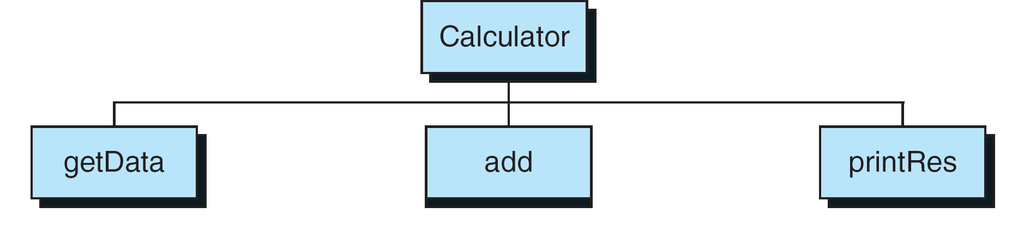
FIGURE 4-33 Calculator Program Design

Slide 95
PROGRAM 4-13
Calculator Program—First Increment

Slide 96
PROGRAM 4-13
Calculator Program—First Increment

Slide 97
PROGRAM 4-13
Calculator Program—First Increment

Slide 98
PROGRAM 4-14
Calculator Program—Second Increment

Slide 99
PROGRAM 4-14
Calculator Program—Second Increment

Slide 100
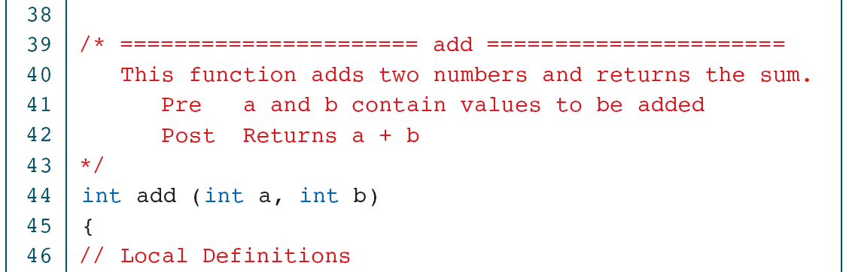
PROGRAM 4-14
Calculator Program—Second Increment

Slide 101
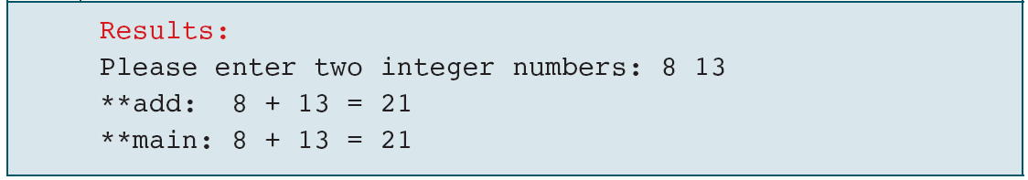
PROGRAM 4-14
Calculator Program—Second Increment

Slide 102
PROGRAM 4-15
Calculator Program—Final Increment

Slide 103
PROGRAM 4-15
Calculator Program—Final Increment

Slide 104
PROGRAM 4-15
Calculator Program—Final Increment

Slide 105
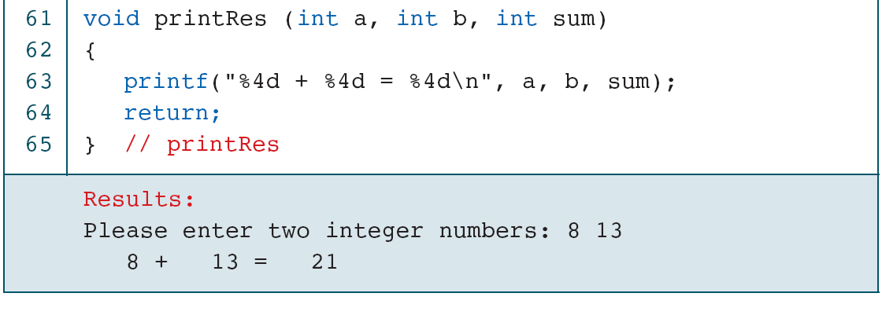
PROGRAM 4-15
Calculator Program—Final Increment

Slide 106
4-8 Software Engineering
In this section we discuss three different but related aspects of software engineering design: the structure chart, functional cohesion, and top–down development.
Topics discussed in this section:
Structure Charts
Structure Chart Rules
Functional Cohesion
Top–Down Development

Slide 107
FIGURE 4-34 Structure Chart Symbols

Slide 108
FIGURE 4-35 Structure Chart Design

Slide 109
Note
Structure charts show only function flow; they contain no code.

Slide 110
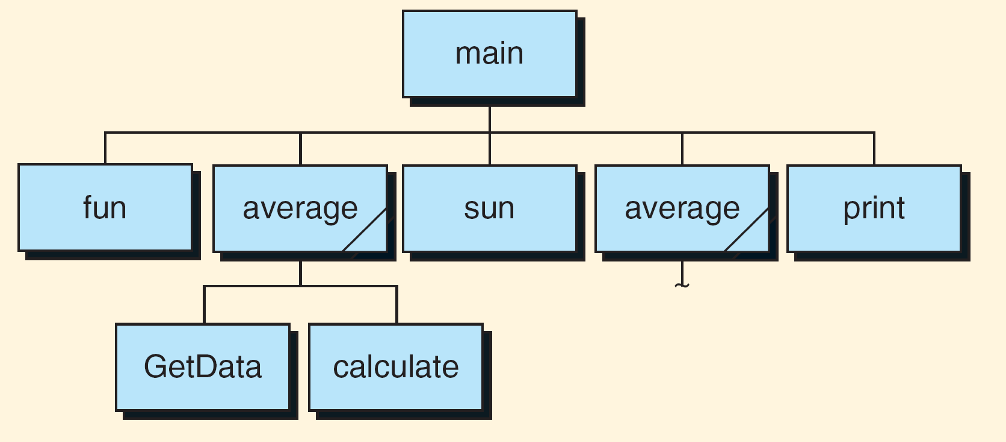
FIGURE 4-36 Common Functions in a Structure Chart

Slide 111
Table 4-1
Structure Chart Rules

Slide 112
FIGURE 4-37 Calculate Taxes Design

Slide 113
FIGURE 4-38 Design For Print Report

Slide 114
Functional Cohesion
Reasons for structurally cohesive functions
Correctness
Maintainability
Reusability
Rules for designing cohesive functions
Only one thing
In one place
Testability

Slide 115
PROGRAM 4-16
Top–down Development Example

Slide 116
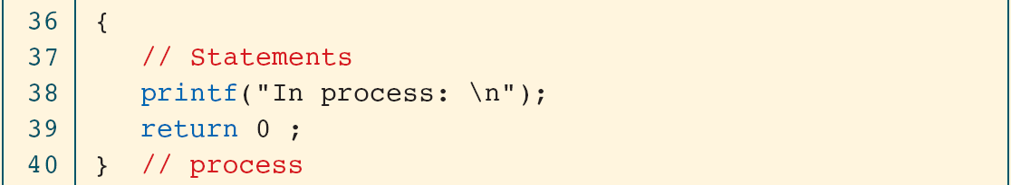
PROGRAM 4-16
Top–down Development Example

Slide 117
PROGRAM 4-16
Top–down Development Example

